Slide 1
Cyber Security Analytics
Draft
Your Name
Your Title or Date

Slide 2

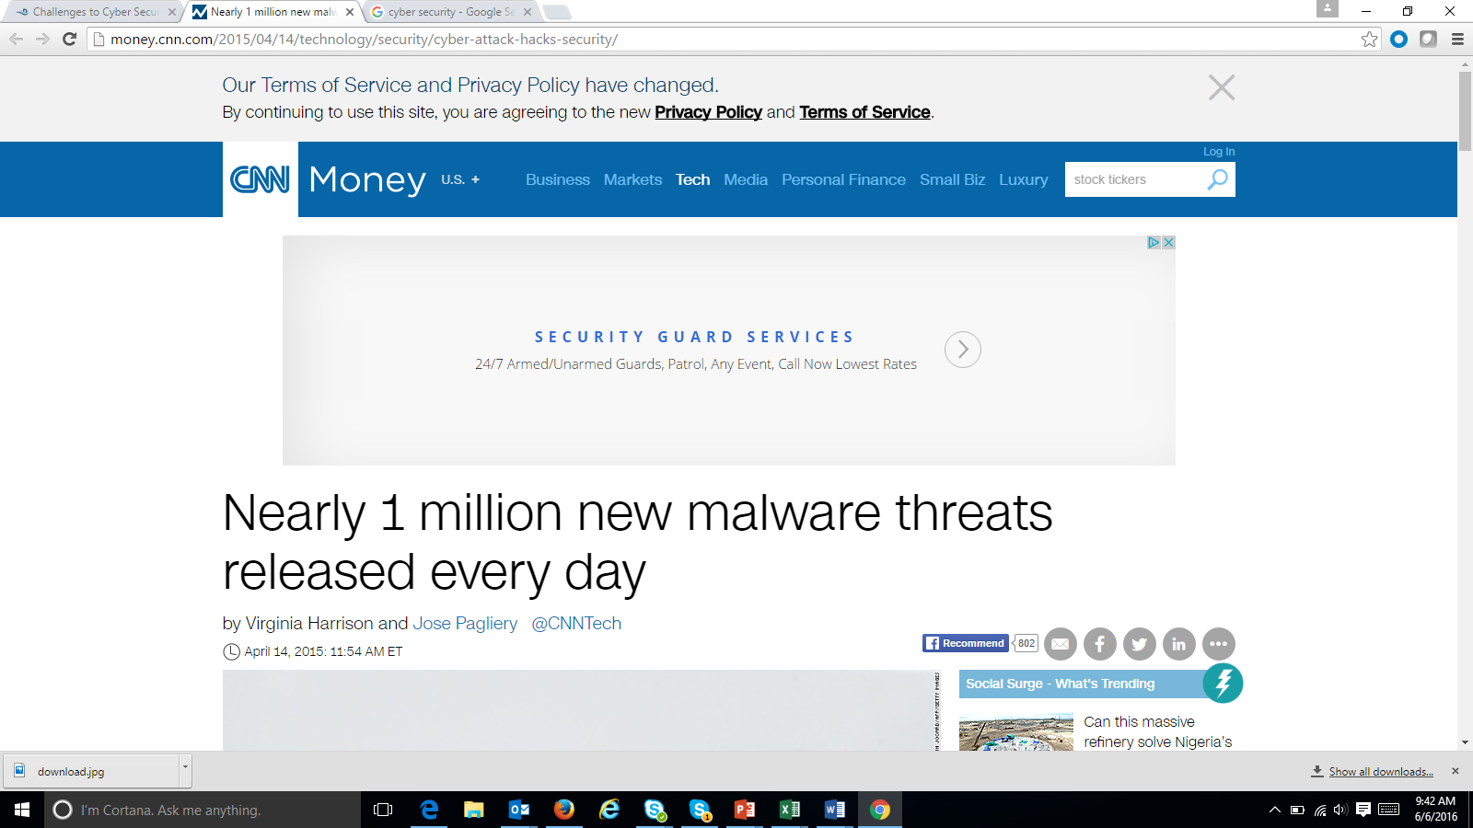
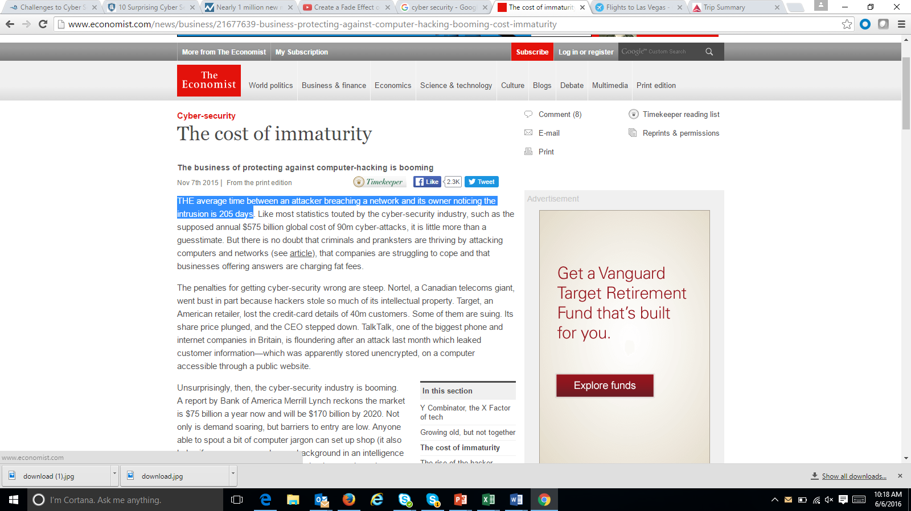
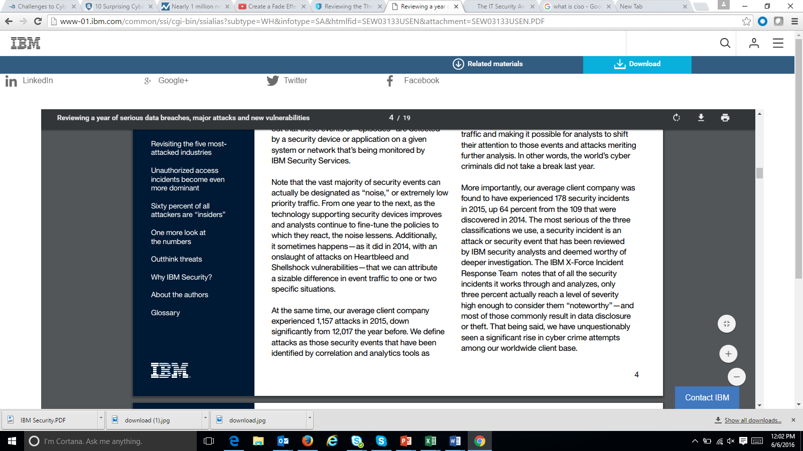
The Challenges of Cyber Attacks
Draft
“1 Million New Cyber Threats per Day”
“50% of all the risks faced by an organization were attributable to phishing”
CISO FORUM 2016
“The average time between an attacker breaching a network and its owner noticing the intrusion is 205 days”
45% of most frequent incidents are unauthorized access of which 60% of the attackers are “insiders”
Notes:
The 1 Million New Cyber Threats per Day quote - http://money.cnn.com/2015/04/14/technology/security/cyber-attack-hacks-security/
http://www.economist.com/news/business/21677639-business-protecting-against-computer-hacking-booming-cost-immaturity
https://securityintelligence.com/ciso-forum-2016-what-is-keeping-cisos-awake-at-night/
http://www-01.ibm.com/common/ssi/cgi-bin/ssialias?subtype=WH&infotype=SA&htmlfid=SEW03133USEN&attachment=SEW03133USEN.PDF

Slide 3
The cost of neglecting Cyber Security
Draft
Compromised Customer Personal Data
Stolen Corporate Intellectual Property
LOSS REVENUE
Exposed Employees Personal Data
Business Disruption
Loss Customer Base
Loss Opportunities
Notes:
Ecommerce is a $3 Trillion Dollar market and Cyber Security can take 15% to 20% of it. http://www.telegraph.co.uk/technology/internet-security/10886640/Cyber-crime-costs-global-economy-445-bn-annually.html
Sony Playstation network shutdown by LulzSec. Revenue Loss $171 Million (2011)
Citigroup – Hacker exploited a basic online vulnerability and stole account information from 200,000 clients. Because of the hacking, Citigroup said it lost $2.7 million.
Hacker breached into Target’s network and took payment cards, a lost of $141 Million.

Slide 4
Barriers to data security adoption
Draft
451 Research – Vormetric 2016 Data Threat Report
Notes:
Data Security
http://enterprise-encryption.vormetric.com/rs/480-LWA-970/images/Vormetric_2016_Data_Threat_Report_Global_WEB.pdf
Next slide will explain complexity in detail

Slide 5
What are some of the complexities?
Draft
Mobile, Cloud, Big Data and IOT
Shortage of Skilled Security Experts
Complexity
More resources required to deploy, operate and maintain
Data Security Products complexity
Today’s threats may not be the same tomorrow
Tasked to do more with less
Notes:
With the adoption of Mobile, Cloud, Big Data and IOT, Cyber attacks can happen at any point of a company’s digital transformation. Vendors offering multiple point tools to solve a specific problem but doesn’t necessarily solves it holistically.
Building a foundation of Cyber Security solution requires more resources to deploy, operate and maintain but Cyber Teams are often under budget and tasked to do more for less.
Data Security Products are complex to deploy and use. A shortage of skilled security experts in the market making it difficult to hold a network fence against cyber intrusion 24/7.
Today’s threats may not be the same tomorrow, therefore, companies need advanced analytics to identify behavioral patterns that leads to predicting cyber attacks.

Slide 6




Cyber Security Through Logs
Draft
A Big Data Problem
# of Log entries per Day
64.8 M Logs
21.6 M Logs
21.6 M Logs
1.4K Logs
4.3K Logs
1 log created every minute
3 different types of logs
Analyze logs from 5K PCs
Analyze logs from 5K mobile devices
Collect logs from 3K machines from 5 data centers
Over 100M logs per day!
Over 21 Billion logs in 205 Days!
Notes:
A log is an accounting record of what happened in a machine or an application through time. It’s one of the better data to analyze cyber intrusion.
Log is a Big Data problem due to the diversity and volume of logs can be recorded in a day. A machine can record a log per minute and can generate 1,440 logs per day. But most company would analyze more than 1 type of log. Sometime 3 applications of logs need to be monitored and that translates to over 4K logs per day.
When the Big Data problem stems from analyzing thousands of PC, thousands of mobile devices and even thousands of machines from 5 different data centers, the volume of logs can be generated from hundreds of millions per day to billions of logs if it takes 205 days to detect cyber intrusion.

Slide 7
Cyber Security – In addition to logs
Draft
Unstructured Data
Source : IDC, The Digital Universe, Dec 2012
Notes:
Log is Semi-Structure because the structure part is only time-stamp, IP address, standards for vlog. But most of it is unstructured. This explains why the unstructured part is growing.
Most Unstructured Data are:
Social Media Data with Personal Credit Card Information
Geo-Location (semi-structured and unstructured) – where is the credit card been used
Emails with attachments and links to bad list of URLs

Slide 8

Challenges with Security Incident and Event Management
Draft
Traditional SIEM
Not designed to handle semi structured and unstructured data.
Not efficient to write new alerts; need programing
Not a hunting tool so it doesn’t do well for behavior intrusion analytics
May need to integrate to other analytics solution
Notes:
Only focus on network logs and not other logs.
Don’t handle semi-structured and unstructured data

Slide 9
Cyber Security
Draft
The Complexity of a Big Data Problem
Internal
Blend Data at Scale
External
Server
Network
Internet
IPR Systems
CRM & ERPS Systems
User Lists
Compromised Websites
Known Phishing Senders
Geo Location
Social Media
In order to do Behavior Intrusion Analysis, you need to blend data at scale to get 360 degree cyber attack view!
Notes:
Next gen cyber security systems – Logs, structured, unstructured semi-structured data from internal and external sources
Ability to scale to petabytes
Blend all data sources at scale and making it ready for correlation across desperate sources.
Ability to setup automated alerts

Slide 10

Why Pentaho Cyber Security Analytics?
Draft
Automate preparation, blending, reporting and alerting of complex variety of data
Fill some of the resource gaps through automation
Integrate predictive analytics for near real time behavioral analytics
Reduces complexity without the deep cost to deploy, maintain and operate.

Slide 11


Blend Logs and Business Data with 360 view - Cyber Security Investigating
Draft
LDAP
Automated Onboarding
Sophos
Hadoop Cluster
Data Integration
Analytic DB
Web Logs
PDI in cluster processing
R, Python Weka
Cyber SecurityAnalytics
On-Demand Integration & Blending
Data Integration
Employees or Outsiders
Existing
ETL Tool
or Pentaho
SIEM
Existing ETL Tool or PDI
Data Marts
BI Tools
External WatchList of URL sites
EDW
Notes:
Pentaho automatic Meta Data Injection and support MapReduce allow customer to leverage the data lake using Hadoop or NoSql. The parsing and meta data management is the hardest part of data lake process and Pentaho can automate this process for you
In addition to bringing data to the data lake. It’s also important to take advantage of Advanced Analytics in the process by integrating algorithms in Hadoop to help detect cyber intrusions and potential threats
We can also blend data from SIEM, HCM and External Watchlist for Cyber Security 360 view.

Slide 12
Greatly improve analysis time
Draft
Months to Never
Logs, Tweets, CRM, Geo data, etc
Parse Logs & Enrichment
In-line Analytics
Alerting
InteractiveAnalytics
Security & Governance
Reporting
Simplified by Pentaho Cyber Security Analytics
Security & Governance
Automated
Automated
Automated
Automated
Automated
Automated
Hours to Minutes
Notes:
Log ingestion, unstructured, semi-structured and unstructured is just bringing the data from a data source into Pentaho.
Parse Logs is doing meta data injection. Enrich the data is blending data like employee, geo-location, device, etc….
Advanced Analytics is leveraging Weka to do intrusion behavior and anomaly detection.
Once an attack is detect, Pentaho can do real time alerting.
Modeling?
Create reports to communicate Cyber Attack activities and analysis to help with decision.
Decision will create better Security & Governance.

Slide 13

Empower Your Team!
Draft
Who can take advantage of the Cyber Security Analytics?
CISO
Cyber Forensic
Cyber Data Analyst
Data Scientist
Notes:
Hadoop is a commodity hardware which requires new skill. We’re allowing your team to use existing skill to work on commodity technology without a huge learning curve. You can triple the productivity of your team. Now your team has more time for the next priority.

Slide 14

Leading Energy Company Use Case
Draft
Problem: Internet violation analysis and data processes are Complex Big Data problems. Existing vendor solution was too slow and required lots of scripting
Pentaho’s Solution: Pentaho is able to remove the scripting and automate the data transformation reducing the time from months to minutes
Benefit: Enables faster reporting of intrusion behavior and provides cleansed data for Data Scientist’s advanced analytic algorithms for Cyber Attack Detection

Slide 15

Leading Telecom Company Use Case
Draft
Problem: Need to identify first time login user of anything – URL, devices, server, applications.
Pentaho’s Solution: Accelerates the log parsing process in Hadoop and integrates Bloomfilter libraries to automate and alert first time users.
Benefit: First time users reporting is reduced to help the forensic team narrow their cyber threat behavior analysis.

Slide 16
How does this applies to you?
Draft
Data Integration
Business Analytics
Automate ingestion, parsing and blending of data
Logs, Content, Transactions
Integrate and process data across environments
RDBMS, NoSQL, Hadoop
Reduce manual development time
Months to Hours
Operationalize behavioral analytic models
R, Python, SQL, WEKA
Consume in the format you preferred
Visualization, Reports and Dashboard
In any environment
On-Premse, in the Cloud

Slide 17

Pentaho Cyber Security Analytics
Draft
Proven Success – end to end data processing and analytics done in 4 hours; competitor’s solution done in 29 days.
Expertise in Big Data
Your Cyber Security Analyst can become a Big Data expert creating new alerts, notification and analysis.
Pentaho reduces the Big Data complexity of data integration and analytics
Notes:
Validate the minutes and days with Bo. Note the customer.

Slide 18
Demo
Draft
Subtitle placeholder
Subtitle placeholder

Slide 19
Results of meta data injection and blending of data create meaningful business insight…
Drill Down capabilities and add regions and type of roles (staff, mgr and VPs)
MAC Address | Company Equipment | First Name | Last Name | Login | Day & Time | Title | start date | end date | email address | Region | Function
00:0a:95:9d:68:16 | Unknown | Mike | Lee | mlee | 3/11/2016 12:33 | Director | Mar-12 | 0 | mike.lee@company.com | America | Marketing
00:0a:60:10B:56:1 | Unknown | Unknown | Unknown | iksogy | 1/2/2016 | Unknown |  |  |  | America
Notes:
AD – MAC Address, user name, computer name
HR Database

Slide 20
Ability to drill down, figuring out the unknown device and the user name
URL | MAC Address | Company Equipment | Asset # | First Name | Last Name | Login | Day & Time | Title | Region | Status
Bestfriend.com | 00:0a:95:9d:68:16 | Iphone 6s | 100001000999D | Mike | Lee | mlee | 3/11/2016 12:33 | Director | America | Full Time
Bestfriend.com | 00:0a:60:10B:56:1 | Unknown |  | Unknown | Unknown | iksogy | 1/2/2016 16:33 | Unknown | America | Not Employee
Bestfriend.com | 01:0d:10:19C:16:0 | Unknown |  | Unknown | Unknown | shoty | 12/13/2015 0:00 | Unknown | America | Not Employee

Slide 21
Monitoring Virus Attack (Optional)
Slide Bar

Slide 22
Cyber Security Analytics – Data Ingestion
Draft
Subtitle placeholder
Subtitle placeholder

Slide 23
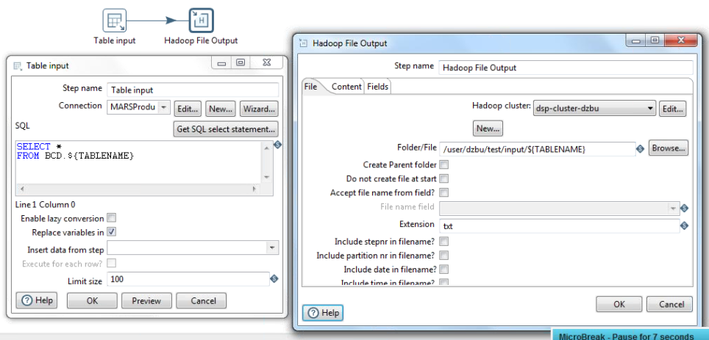
SQL Server to HDFS
Generic, re-usable transformation to copy any SQL Server table to HDFS.
${TABLENAME} parameter is used to determine source and target.
1M records transferred in 1.5 minutes.

Slide 24
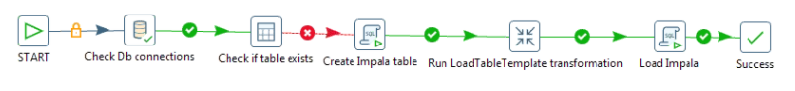
Data Ingestion Workflow
Generic, re-usable workflow for data migration to Impala
Check DB connection is up.
Check if the table exists in Impala and, if not
Run DDL statement to create Impala table
Run transformation template (with ${TABLENAME} parameter) to load SQL server table into HDFS.
Load data into Impala.
The workflow is also parameterized as a generic template so that you can loop over a list of tables and migrate them all to Impala. This can be done in parallel for large migrations.

Slide 25
Cyber Security Analytics – Big Data Processing
Draft
Subtitle placeholder
Subtitle placeholder

Slide 26
Semi-structured log files
Variable and nested data structures
Semi-structured data such as many log files present challenges not found in row/column-based traditional data.
RowHeader key1=val1 key2=val2 key3=val3
RowHeader key2=val2 key1=val1
RowHeader key1=val1 key3=val3 key2=val2
The example above has 3 issues to address:
The row is comprised of two components at a high level: a RowHeader prefix and a set of key/value pairs.
Not all key/value pairs are in each row
The key/values appear in different order.
In addition, new keys may appear in logs after upgrades. These keys should be automatically detected and processed.
Pentaho has specific features to simplify parsing this type of data dynamically.

Slide 27
Semi-structured log file examples
Active Directory events, Sophos anti-virus logs, and Web proxy logs
Active Directory event logs:
<12>Mar 18 23:58:55 146.36.82.32 AgentDevice=WindowsLog AgentLogFile=Security Source=Microsoft-Windows-Security-Auditing Computer=pc1.example.com User= Domain= EventID=1234 EventIDCode=5678 EventType=7 EventCategory=14389 … (additional KEY=VALUE pairs)
Sophos anti-virus:
1427345811234 146.36.80.61 LEEF:1.0|Sophos|Enterprise Console|1.0|Device control - Alert only|cat=EnterpriseConsole devTimeFormat=yyyy-MM-dd HH:mm:ss EventID=4161234 src=111.222.133.144 ComputerName=PC123 domain=MS ComputerID=52123 devTime=2015-05-26 04:52:43 EventTypeID=7 EventTypeName=Device control … (additional KEY=VALUE pairs)
Web proxy logs:
115.26.37.48 MS\jdoe Java/1.7.0_04 - 4/1/2015 0:00 - PC123 - 11.22.33.44 55.22.33.77 8080 - 376 327 http - POST http://11.22.88.77:80/IA/SocketServlet ...

Slide 28
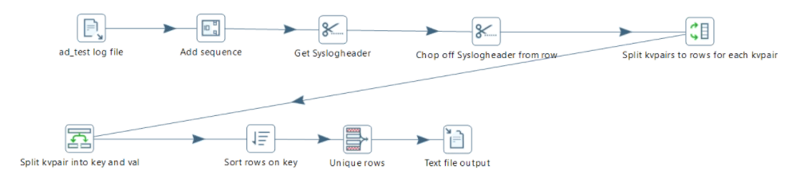
Dynamic Metadata Extraction
Scanning logs to determine metadata
We developed a generic transformation template to scan for all possible keys in a log file.

Slide 29
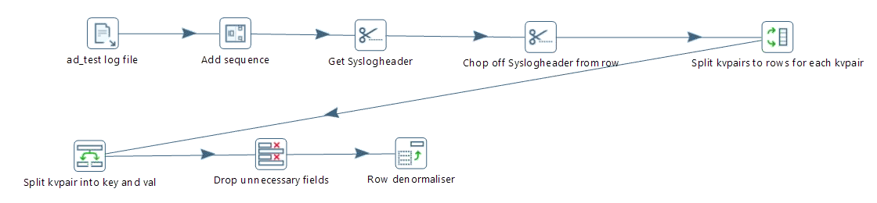
Log Parsing Template
Generic, parameterized template for parsing logs
We developed a generic transformation template for parsing the logs.
The template accepts a list of keys to extract at run-time.
Key/value pairs may vary from row to row
Key/value pairs may appear in any order

Slide 30
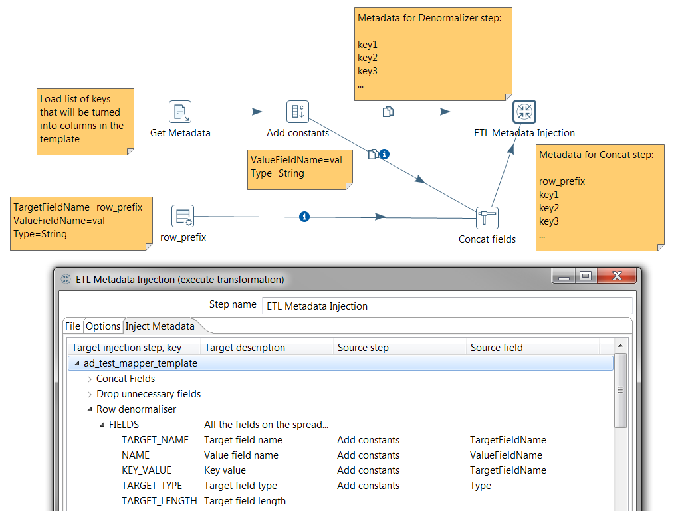
Dynamic Metadata Injection
Inject metadata into a transformation template at run time.
Multiple metadata lists may be injected into the same template for use at different steps within the template.

Slide 31
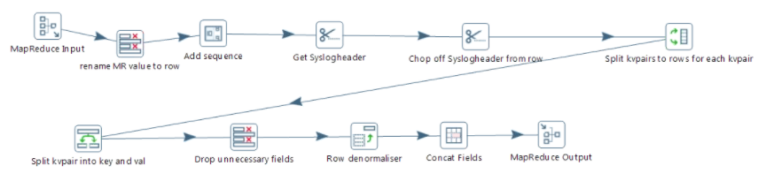
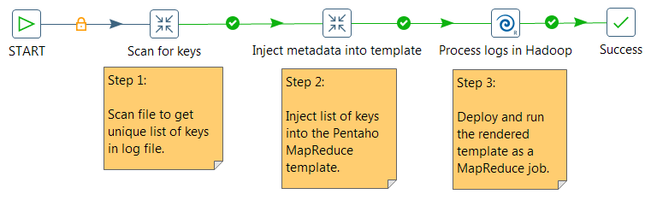
Pentaho MapReduce
We converted the template to run as a Pentaho MapReduce job
Modifying the transformation to run on Hadoop only required changing the end points. All the logic remained the same.
A simple workflow automates the entire process.

Slide 32
Cyber Security Analytics – Business Analytics
Draft
Subtitle placeholder
Subtitle placeholder

Slide 33
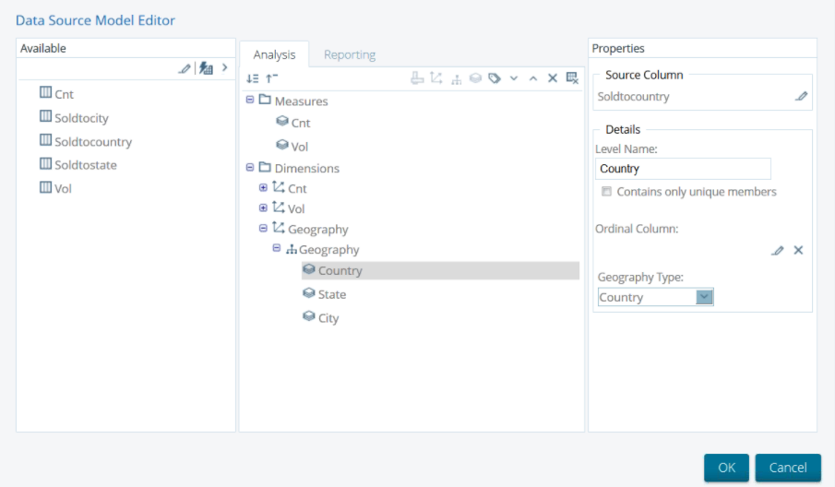
Data Source Wizard

Slide 34
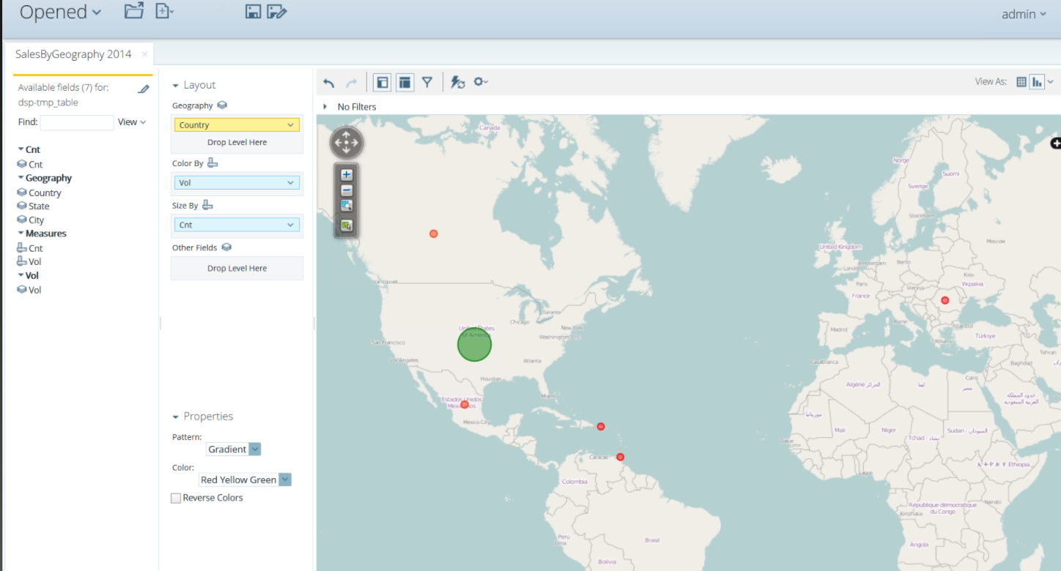
Geo-mapping
Notes:
Create a geographic map using the model with Google Maps visualizing two metrics:
Color dots by volume
Size dots by record count

Slide 35
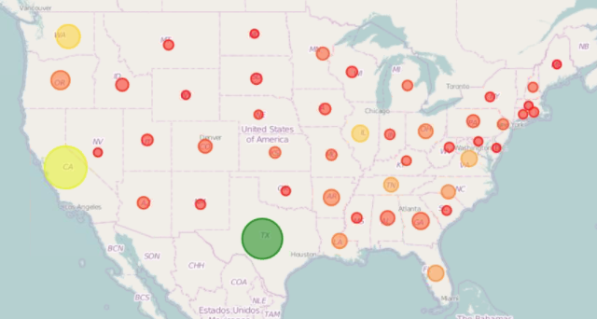
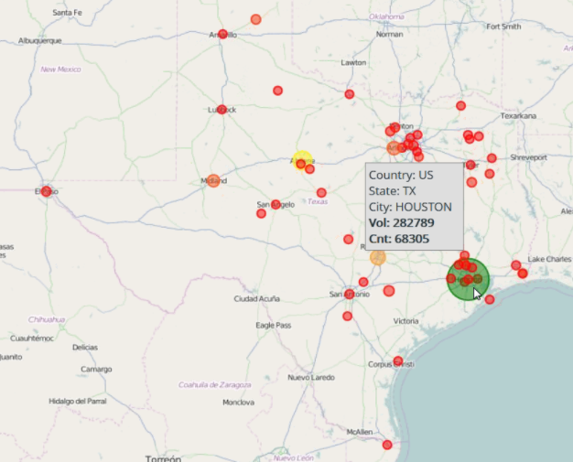
Drill Down
A Country > State > City … hierarchy was created in the model to support drill down.

Slide 36
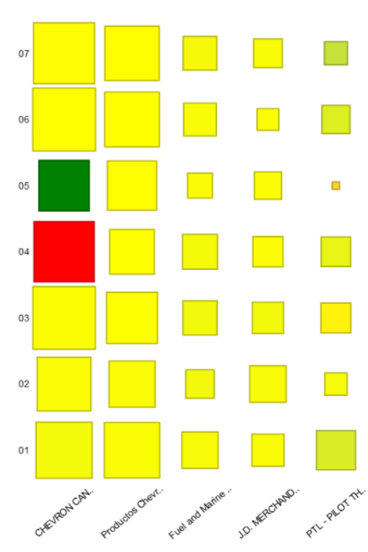
Sales Transactions Heat Map
We modeled sales transaction data and created a heat map of top customers by volume for 1st half of 2015.
Size of block represents Volume.
Color gradient represents NOI.
Total development time: 10 minutes.

Slide 37
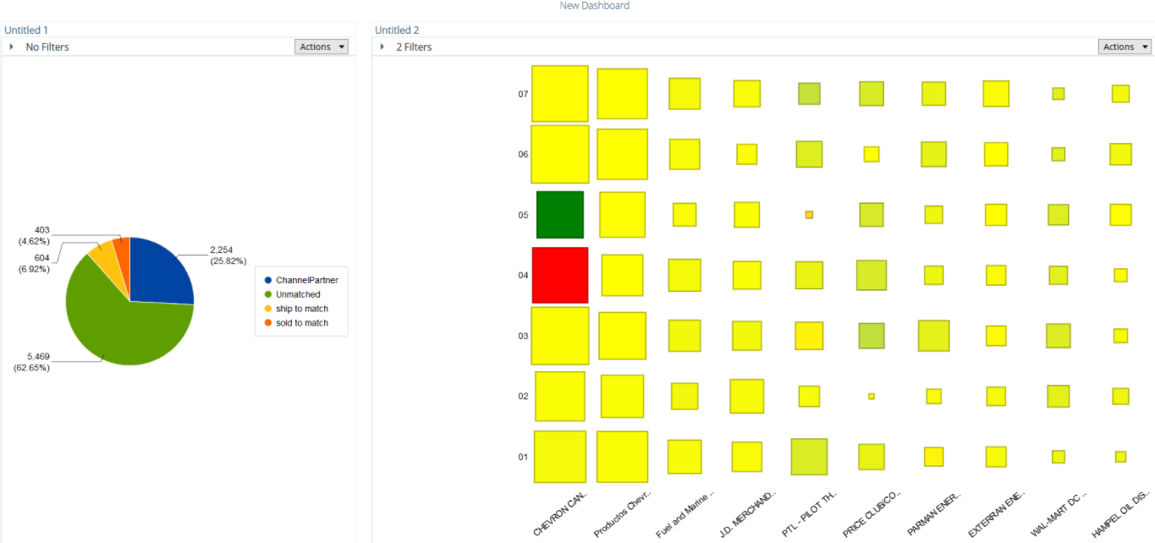
Dashboarding
We put together a simple dashboard showing two of our visualizations using the web-based dashboard designer in 5 minutes.
Single-sign-on (SSO) and Active Directory roles can be used to control access.

Slide 38
Summary
Key findings from the POC
Pentaho provides unique capabilities for building end-to-end solutions around data science and big data.
This proof-of-concept demonstrates the following key advantages of using Pentaho:
Faster time to delivery for ingestion, processing, and analysis of big data.
Albert and Irene were able to accomplish in a few hours what took days using previous manual methods.
Lowered risk by providing a supported, enterprise-class production platform.
Lower total cost of ownership by simplifying both the effort and skillsets required to deliver, enhance, and maintain solutions.

Slide 39
Questions and Discussion

Slide 40
Thank You

